Slide 1
Types
cs242
Kathleen Fisher
Reading: “Concepts in Programming Languages”, Chapter 6

Slide 2
Outline
General discussion of types
  What is a type?
  Compile-time vs run-time checking
  Conservative program analysis
Type inference
  Will study algorithm and examples
  Good example of static analysis algorithm
Polymorphism
  Uniform vs non-uniform impl of polymorphism
  Polymorphism vs overloading

Slide 3
Language Goals and Trade-offs
Thoughts to keep in mind
  What features are convenient for programmer?
  What other features do they prevent?
  What are design tradeoffs?
    Easy to write but harder to read?
    Easy to write but poorer error messages?
  What are the implementation costs?
Architect
Programmer
Programming Language
Tester
Compiler,
Runtime environ-ment
DiagnosticTools

Slide 4
What is a type?
A type is a collection of computable values that share some structural property.
Examples
Non-examples
Integer
String
Int → Bool
(Int → Int) → Bool
{3, True, \x->x}
Even integers
{f:Int → Int | x>3 =>
f(x) > x *(x+1)}
Distinction between sets of values that are types and sets that are not types is language dependent.
Notes:
Miranda has only a single type of integer, of arbitrary precision, so the set of integers representable in 32 bits is not a type.
In contrast, languages in development now have dependent type systems in which it is possible to represent types such as the “even” integers. Often such languages require the programmer to provide a proof that a given expression will be even, however, or permit the type system to be undecidable.

Slide 5
Uses for Types
Program organization and documentation
  Separate types for separate concepts
    Represent concepts from problem domain
  Indicate intended use of declared identifiers
    Types can be checked, unlike program comments
Identify and prevent errors
  Compile-time or run-time checking can prevent meaningless computations such as 3 + true – “Bill”
Support optimization
  Example: short integers require fewer bits
  Access record component by known offset
Notes:
What is a type error?

Slide 6
What is a type error?
A type error is something the compiler/interpreter reports when I make a mistake in my syntactically correct program?
Languages represent values as sequences of bits. A type error occurs when a bit sequence written for one type is used as a bit sequence for another type?
A type error occurs when a value is used in a way inconsistent with its definition.
Notes:
But how does the compiler know when to issue a type error?
But sometimes we have different types that share the same representation: Student IDs and phone numbers, as a possible example.
High level definition: how can you tell what is consistent with definition?

Slide 7
Type errors are language dependent
Array out of bounds access
  C/C++: runtime errors.
  Haskell/Java: dynamic type errors.
Null pointer dereference
  C/C++: null pointer dereferences are run-time errors.
  In Haskell/ML, pointers are hidden inside datatypes. Null pointer dereferences correspond to incorrect use of these datatypes. Such errors are static type errors.

Slide 8
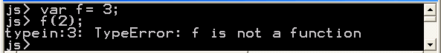
Compile-time vs Run-time Checking
JavaScript and Lisp use run-time type checking
  f(x) Make sure f is a function before calling f.
ML and Haskell use compile-time type checking
  f(x) Must have f :: A → B and x :: A
Basic tradeoff
  Both kinds of checking prevent type errors.
  Run-time checking slows down execution.
  Compile-time checking restricts program flexibility.
    JavaScript array: elements can have different types
    Haskell list: all elements must have same type
  Which gives better programmer diagnostics?

Slide 9
Expressiveness
In JavaScript, we can write a function like
  Some uses will produce type error, some will not.
Static typing always conservative
Cannot decide at compile time if run-time error will occur!
function f(x) { return x < 10 ? x : x(); }
  if (big-hairy-boolean-expression)
  then f(5);
  else f(15);

Slide 10
Relative Type-Safety of Languages
Not safe: BCPL family, including C and C++
  Casts, pointer arithmetic
Almost safe: Algol family, Pascal, Ada.
  Dangling pointers.
    Allocate a pointer p to an integer, deallocate the memory referenced by p, then later use the value pointed to by p.
    No language with explicit deallocation of memory is fully type-safe.
Safe: Lisp, Smalltalk, ML, Haskell, Java, JavaScript
  Dynamically typed: Lisp, Smalltalk, JavaScript
  Statically typed: ML, Haskell, Java
Notes:
Why does pointer arithmetic make a language unsafe?

Slide 11
Type Checking vs.Type Inference
Standard type checking:
  Examine body of each function. Use declared types to check agreement.
Type inference:
  Examine code without type information. Infer the most general types that could have been declared.
int f(int x) { return x+1; };
int g(int y) { return f(y+1)*2; };
int f(int x) { return x+1; };
int g(int y) { return f(y+1)*2; };
ML and Haskell are designed to make type inference feasible.

Slide 12
Why study type inference?
Types and type checking
  Improved steadily since Algol 60
    Eliminated sources of unsoundness.
    Become substantially more expressive.
  Important for modularity, reliability and compilation
Type inference
  Reduces syntactic overhead of expressive types.
  Guaranteed to produce most general type.
  Widely regarded as important language innovation.
  Illustrative example of a flow-insensitive static analysis algorithm.

Slide 13
History
Original type inference algorithm was invented by Haskell Curry and Robert Feys for the simply typed lambda calculus in 1958.
In 1969, Hindley extended the algorithm to a richer language and proved it always produced the most general type.
In 1978, Milner independently developed equivalent algorithm, called algorithm W, during his work designing ML.
In 1982, Damas proved the algorithm was complete.
Already used in many languages: ML, Ada, Haskell, C# 3.0, F#, Visual Basic .Net 9.0, and soon in: Fortress, Perl 6, C++0x

Slide 14
uHaskell
Subset of Haskell to explain type inference.
  Haskell and ML both have overloading, which slightly complicates type inference. We won’t worry about type inference with overloading.
<decl> ::= [<name> <pat> = <exp>]
<pat> ::=Id | (<pat>, <pat>) | <pat> : <pat> | []
<exp> ::= Int | Bool | [] | Id | (<exp>)
| <exp> <op> <exp>
| <exp> <exp> | (<exp>, <exp>)
| if <exp> then <exp> else <exp>

Slide 15
Type Inference: Basic Idea
Example
What is the type of f?
  + has type: Int → Int → Int
  2 has type: Int
  Since we are applying + to x we need x :: Int
  Therefore f x = 2 + x has type Int → Int
f x = 2 + x
> f :: Int -> Int
Overloaded functions introduce more cases to consider.

Slide 16
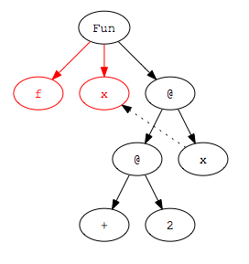
Step 1: Parse Program
Parse program text to construct parse tree.
f x = 2 + x
Infix operators are converted to normal function application during parsing:
2 + x --> (+) 2 x

Slide 17
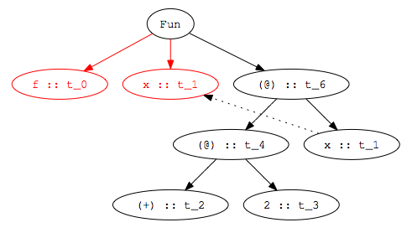
Step 2:
Assign type variables to nodes
f x = 2 + x
Variables are given same type as binding occurrence.

Slide 18
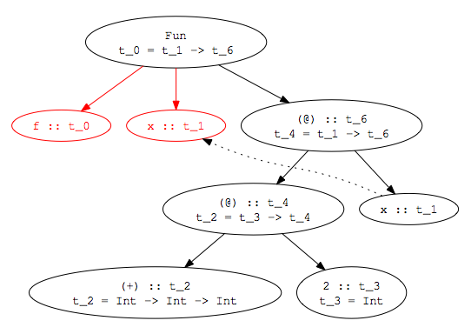
Step 3: Add Constraints
f x = 2 + x
t_0 = t_1 -> t_6
t_4 = t_1 -> t_6
t_2 = t_3 -> t_4
t_2 = Int -> Int -> Int
t_3 = Int
Notes:
Some constraints come from the environment. We know that 2 has type Int, for example, and (+) has type Int -> Int -> Int (at last in uHaskell!)
Other constraints come from the structure of the parse tree. If we have an application node (@), for example, then we know the first child has to be a function. Furthermore, the type of the argument to the function must be the type of the second child of the application node. The type of the application node itself must be the same as the return type of the function.

Slide 19
Step 4: Solve Constraints
t_0 = t_1 -> t_6
t_4 = t_1 -> t_6
t_2 = t_3 -> t_4
t_2 = Int -> Int -> Int
t_3 = Int
t_3 -> t_4 = Int -> (Int -> Int)
t_3 = Int
t_4 = Int -> Int
t_0 = t_1 -> t_6
t_4 = t_1 -> t_6
t_4 = Int -> Int
t_2 = Int -> Int -> Int
t_3 = Int
t_1 -> t_6 = Int -> Int
t_0 = Int -> Int
t_1 = Int
t_6 = Int
t_4 = Int -> Int
t_2 = Int -> Int -> Int
t_3 = Int
t_1 = Int
t_6 = Int

Slide 20
Step 5:
Determine type of declaration
t_0 = Int -> Int
t_1 = Int
t_6 = Int -> Int
t_4 = Int -> Int
t_2 = Int -> Int -> Int
t_3 = Int
f x = 2 + x
> f :: Int -> Int

Slide 21
Type Inference Algorithm
Parse program to build parse tree
Assign type variables to nodes in tree
Generate constraints:
  From environment: constants (2), built-in operators (+), known functions (tail).
  From form of parse tree: e.g., application and abstraction nodes.
Solve constraints using unification.
Determine types of top-level declarations.

Slide 22
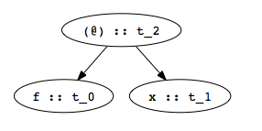
Constraints from Application Nodes
f x
  Apply function f to argument x:
  Because f is being applied, its type (t_0 in figure) must be a function type: domain → range.
  Domain of f must be type of argument x (t_1 in figure).
  Range of f must be result type of expression (t_2 in figure).
  Hence we get the constraint: t_0 = t_1 -> t_2
t_0 = t_1 -> t_2

Slide 23
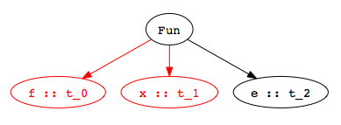
Constraints from Abstractions
f x = e
Function declaration:
  Type of function f (t_0 in figure) must be a function type: domain → range.
  Domain is type of abstracted variable x (t_1 in figure).
  Range is type of function body e (t_2 in figure).
  Hence we get the constraint: t_0 = t_1 -> t_2.
t_0 = t_1 -> t_2

Slide 24
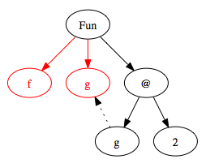
Inferring Polymorphic Types
f g = g 2
> f :: (Int -> t_4) -> t_4
Example:
Step 1: Build Parse Tree
Notes:
Try building the parse tree yourself.

Slide 25
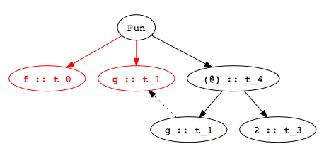
Inferring Polymorphic Types
f g = g 2
> f :: (Int -> t_4) -> t_4
Example:
Step 2: Assign type variables

Slide 26
Inferring Polymorphic Types
f g = g 2
> f :: (Int -> t_4) -> t_4
Example:
Step 3: Generate constraints
t_0 = t_1 -> t_4
t_1 = t_3 -> t_4
t_3 = Int
Notes:
Try generating constraints yourself.

Slide 27
Inferring Polymorphic Types
f g = g 2
> f :: (Int -> t_4) -> t_4
Example:
Step 4: Solve constraints
t_0 = t_1 -> t_4
t_1 = t_3 -> t_4
t_3 = Int
t_0 = (Int -> t_4) -> t_4
t_1 = Int -> t_4
t_3 = Int

Slide 28
Inferring Polymorphic Types
f g = g 2
> f :: (Int -> t_4) -> t_4
Example:
Step 5: Determine type of top-level declaration
Unconstrained type variables become polymorphic types.
t_0 = (Int -> t_4) -> t_4
t_1 = Int -> t_4
t_3 = Int

Slide 29
Using Polymorphic Functions
f g = g 2
> f :: (Int -> t_4) -> t_4
Function:
Possible applications:
add x = 2 + x
> add :: Int -> Int
f add
> 4 :: Int
isEven x = mod (x, 2) == 0
> isEven:: Int -> Bool
f isEven
> True :: Int

Slide 30
Recognizing Type Errors
f g = g 2
> f :: (Int -> t) -> t
Function
Incorrect use
Type error: cannot unify Bool → Bool and Int → t
not x = if x then True else False
> not :: Bool -> Bool
f not
> Error: operator and operand don’t agree
operator domain: Int -> a
operand: Bool -> Bool

Slide 31
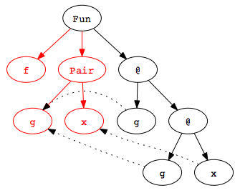
Another Example
f (g,x) = g (g x)
> f :: (t_8 -> t_8, t_8) -> t_8
Example:
Step 1: Build Parse Tree
Notes:
This example shows how the pair pattern is handled in type inference.

Slide 32
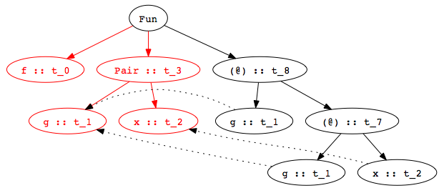
Another Example
f (g,x) = g (g x)
> f :: (t_8 -> t_8, t_8) -> t_8
Example:
Step 2: Assign type variables

Slide 33
Another Example
f (g,x) = g (g x)
> f :: (t_8 -> t_8, t_8) -> t_8
Example:
Step 3: Generate constraints
t_0 = t_3 -> t_8
t_3 = (t_1, t_2)
t_1 = t_7 -> t_8
t_1 = t_2 -> t_7

Slide 34
Another Example
f (g,x) = g (g x)
> f :: (t_8 -> t_8, t_8) -> t_8
Example:
Step 4: Solve constraints
t_0 = t_3 -> t_8
t_3 = (t_1, t_2)
t_1 = t_7 -> t_8
t_1 = t_2 -> t_7
t_0 = (t_8 -> t_8, t_8) -> t_8
Notes:
t_0 = (t_1, t_2) -> t_8
t_7 = t_2
t_8 = t_8
so, t_0 = (t_8 -> t_8, t_8) -> t_8

Slide 35
Another Example
f (g,x) = g (g x)
> f :: (t_8 -> t_8, t_8) -> t_8
Example:
Step 5: Determine type of f
t_0 = t_3 -> t_8
t_3 = (t_1, t_2)
t_1 = t_7 -> t_8
t_1 = t_2 -> t_7
t_0 = (t_8 -> t_8, t_8) -> t_8
Notes:
t_0 = (t_1, t_2) -> t_8
t_7 = t_2
t_8 = t_8
so, t_0 = (t_8 -> t_8, t_8) -> t_8

Slide 36
Polymorphic Datatypes
Often, functions over datatypes are written with multiple clauses:
Type inference
  Infer separate type for each clause
  Combine by adding constraint that the types of the branches must be equal.
length [] = 0
length (x:rest) = 1 + (length rest)

Slide 37
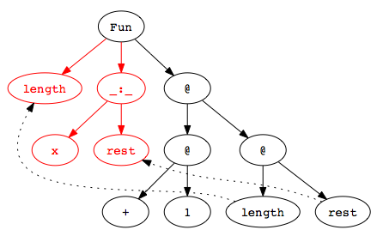
Type Inference with Datatypes
Example:
Step 1: Build Parse Tree
length (x:rest) = 1 + (length rest)

Slide 38
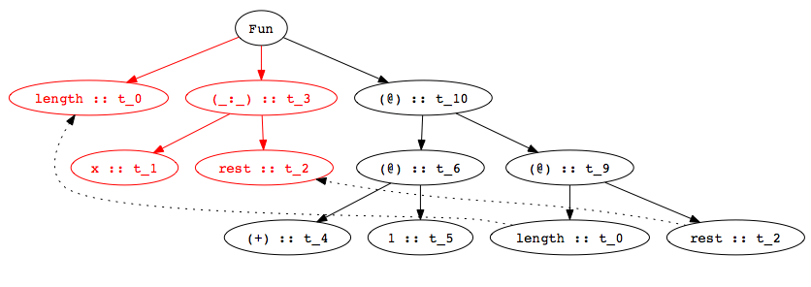
Type Inference with Datatypes
Example:
Step 2: Assign type variables
length (x:rest) = 1 + (length rest)

Slide 39
Type Inference with Datatypes
Example:
Step 3: Gen. constraints
length (x:rest) = 1 + (length rest)
t_0 = t_3 -> t_10
t_3 = t_2
t_3 = [t_1]
t_6 = t_9 -> t_10
t_4 = t_5 -> t_6
t_4 = Int -> Int -> Int
t_5 = Int
t_0 = t_2 -> t_9

Slide 40
Type Inference with Datatypes
Example:
Step 3: Solve Constraints
length (x:rest) = 1 + (length rest)
t_0 = t_3 -> t_10
t_3 = t_2
t_3 = [t_1]
t_6 = t_9 -> t_10
t_4 = t_5 -> t_6
t_4 = Int -> Int -> Int
t_5 = Int
t_0 = t_2 -> t_9
t_0 = [t_1] -> Int
Notes:
Note that this same procedure handles recursive function invocations with no special cases…

Slide 41
Multiple Clauses
Function with multiple clauses
Infer type of each branch
  First branch:
  Second branch:
Combine by equating types of two branches:
append ([],r) = r
append (x:xs, r) = x : append (xs, r)
> append :: ([t_1], t_2) -> t_2
> append :: ([t_3], t_4) -> [t_3]
> append :: ([t_1], [t_1]) -> [t_1]

Slide 42
Most General Type
Type inference is guaranteed to produce the most general type:
Function has many other, less general types:
Less general types are all instances of most general type, also called the principal type.
map (f, [] ) = []
map (f, x:xs) = f x : map (f, xs)
> map :: (t_1 -> t_2, [t_1]) -> [t_2]
> map :: (t_1 -> Int, [t_1]) -> [Int]
> map :: (Bool -> t_2, [Bool]) -> [t_2]
> map :: (Char -> Int, [Char]) -> [Int]

Slide 43
Type Inference Algorithm
When the Hindley/Milner type inference algorithm was developed, its complexity was unknown.
In 1989, Kanellakis, Mairson, and Mitchell proved that the problem was exponential-time complete.
Linear in practice though…

Slide 44
Information from Type Inference
Consider this function…
… and its most general type:
What does this type mean?
reverse [] = []
reverse (x:xs) = reverse xs
> reverse :: [t_1] -> [t_2]
Reversing a list does not change its type, so there must be an error in the definition of reverse!
See Koenig paper on “Reading” page of CS242 site

Slide 45
Type Inference: Key Points
Type inference computes the types of expressions
  Does not require type declarations for variables
  Finds the most general type by solving constraints
  Leads to polymorphism
Sometimes better error detection than type checking
  Type may indicate a programming error even if no type error.
Some costs
  More difficult to identify program line that causes error.
  Natural implementation requires uniform representation sizes.
  Complications regarding assignment took years to work out.
Idea can be applied to other program properties
  Discover properties of program using same kind of analysis

Slide 46
Haskell Type Inference
Haskell uses type classes to support user-defined overloading, so the inference algorithm is more complicated.
ML restricts the language to ensure that no annotations are required, ever.
Haskell provides various features like polymorphic recursion for which types cannot be inferred and so the user must provide annotations.
Notes:
Tool for doing type inference for uHaskell programs will be available on the pod machines shortly. It can generate the various parse trees we’ve been seeing in the slides, so you can use it to play with how type inference works. In addition, the tool is written in Haskell itself, so you can look at it as an example of a small but real program written in the language. I’ll post information about where it is, etc on courseware. It is work in progress, so if you find bugs, feel free to send me email reporting them.

Slide 47
Parametric Polymorphism:
Haskell vs C++
Haskell polymorphic function
  Declarations (generally) require no type information.
  Type inference uses type variables to type expressions.
  Type inference substitutes for variables as needed to instantiate polymorphic code.
C++ function template
  Programmer must declare the argument and result types of functions.
  Programmers must use explicit type parameters to express polymorphism.
  Function application: type checker does instantiation.

Slide 48
Example: Swap Two Values
Haskell
C++
swap :: (IORef a, IORef a) -> IO ()
swap (x,y) = do {
val_x <- readIORef x; val_y <- readIORef y;
writeIORef y val_x; writeIORef x val_y;
return () }
  template <typename T>
  void swap(T& x, T& y){
  T tmp = x; x=y; y=tmp;
  }
Declarations both swap two values polymorphically, but they are compiled very differently.

Slide 49
Implementation
Haskell
  Swap is compiled into one function
  Typechecker determines how function can be used
C++
  Swap is compiled into linkable format
  Linker duplicates code for each type of use
Why the difference?
  Haskell ref cell is passed by pointer. The local x is a pointer to value on heap, so its size is constant.
  C++ arguments passed by reference (pointer), but local x is on the stack, so its size depends on the type.

Slide 50
Another Example
C++ polymorphic sort function
What parts of code depend on the type?
  Indexing into array
  Meaning and implementation of <
  template <typename T>
  void sort( int count, T * A[count ] ) {
  for (int i=0; i<count-1; i++)
  for (int j=i+1; j<count-1; j++)
  if (A[j] < A[i]) swap(A[i],A[j]);
  }

Slide 51
Polymorphism vs Overloading
Parametric polymorphism
  Single algorithm may be given many types
  Type variable may be replaced by any type
  if f::t→t then f::Int→Int, f::Bool→Bool, ...
Overloading
  A single symbol may refer to more than one algorithm
  Each algorithm may have different type
  Choice of algorithm determined by type context
  Types of symbol may be arbitrarily different
  In ML, + has types int*int→int, real*real→real, no others

Slide 52
Summary
Types are important in modern languages
  Program organization and documentation
  Prevent program errors
  Provide important information to compiler
Type inference
  Determine best type for an expression, based on known information about symbols in the expression
Polymorphism
  Single algorithm (function) can have many types
Overloading
  One symbol with multiple meanings, resolved at compile time

