Slide 1
Science: Ways of Knowing
Computational Freakonomics
Chapter 1 Coursenotes
Guzdial

Slide 2
Poll
What’s your favorite ice cream?
  Vanilla
  Chunky Monkey
  Cherry Garcia
  Extreme Moose Tracks

Slide 3
What was wrong with that poll?
Can I make a claim about what ice cream that GT undergraduate students like?

Slide 4
How do we decide to believe something?
Tenacity
Authority
Reason
Common Sense
Notes:
Tenacity: “We have always thought this way.” Like: “You can’t teach an old dog new tricks”
Authority: Religion, one’s party.
Reason: Syllogism.
Are the original assumptions right?
Is it knowable at all? Newtonian view of the world. Chaos.
Common sense: Direct experience. Can help us
- Misconceptions in physics, how things fall.
- Dweck’s fixed vs. growth mindset.

Slide 5
The incumbent usually wins elections.
Which forms of reasoning are people using?
  Tenacity
  Authority
  Reason
  Common Sense
Notes:
Probably not tenacity.
The rest are all reasonable answers.

Slide 6
General methods of science
Dispassionately observe by means of our sense,
Using reason to compare various theoretical conceptualizations based on experience.
Real scientists don’t really use the “Scientific Method.” (Nancy Nerssessian)
  They build models
Good science is replicable and falsifiable.

Slide 7
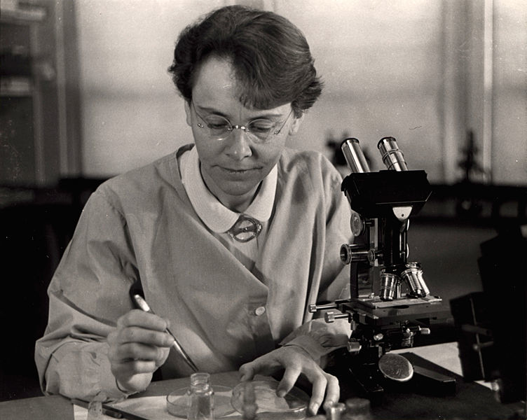
Naturalistic Observation
If you don’t know much, watch it and characterize it.
Big questions:
  Get involved or not?
  How be dispassionate
  How be falsifiable
Examples:
  Barbara McClintock in Biology
  Design-based research in Education

Slide 8
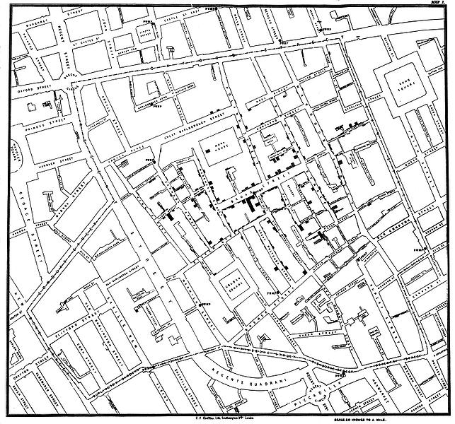
Correlational Approach
If one event occurs, does the other one, too?
Examples:
  Smoking and lung cancer
  1854 Cholera outbreak, John Snow

Slide 9
Problems of correlational approach
What if multiple variables?
  South African President Thabo Mbeki's embrace of AIDS-denialist claims: The resulting governmental refusal to provide effective anti-HIV treatment in South Africa has been blamed for hundreds of thousands of premature AIDS-related deaths in South Africa.
What if non-linear?
Notes:
Alcohol doesn’t cause brain damage (directly). If you’re pregnant, effect on baby.

Slide 10
Internal validity
Do we believe it?
Ecological validity
  In vitro vs. In vivo

Slide 11
Experiment: Relaxation techniques
Gymnastics team wants to improve their mental game.
Teach relaxation techniques.
  If scores go up after the relaxation techniques, did it work?

Slide 12
Experimental Method
Treatment/experimental group vs.
Comparison/control group
Operational definitions: What are you going to measure?
Beware the Hawthorne Effect.
  Taxicab drivers, rear lights, front end vs. back end experiments
  Ann Brown and “feeling special”

Slide 13
Time series design
Within-subjects design
  Pre and post testing
Between-subjects design
  Compare two different groups
Time series design: Within-subjects design
  That’s what our gymnastics experiment is
Interrupted time series design: Multiple tests before or after
  Check multiple meets before and multiple after.
  Was the change “lasting”?
  Variance?
Notes:
Start second week here.

Slide 14
Multiple time series design
Do before/after, but between different subjects or populations.
Does having a bottle deposit impact litter?
  You could before/after, but maybe that state is special?
  Compare two states at the same times.
  New York (with deposit): 260 items of litter -> 145.
  New Jersey (no deposit): 221 -> 214
Alternative explanations? Assumptions?

Slide 15
Classify the Experiment
Looking at student grades, before a suspect teacher, with a suspect teacher, after a suspect teacher.
Correlational design
Naturalistic observation
Multiple time series design
Interrupted time series design

Slide 16
Classify the Experiment
Look at Sumo wrestlers, A vs. B, when A is 6-8 and B is 7-7, and other times that A vs. B.
Interrupted time series design
Between-subjects design
Multiple time series design
Correlational design

Slide 17
Retrospective Design
You know the end result.
You split the participant pool based on end result.
You go back in time, to gather data to compare two groups.
Example: High school activities => Schizophrenia

Slide 18
Correlational Design
Collect information between two variables.
Does one vary at the same time (same amounts) as the other?
Assumptions:
  Third variable?
  Non-linear?
Can “control” for variables.

Slide 19
Key issue: Correlation does not imply causation
Skirt length and stock prices are highly correlated.
Student performance goes up in smaller classes.

Slide 20
Operational Definition
You can’t always measure the thing you want.
So you measure something that you believe represents the same thing.
May not always be true.
  Knowledge and grades.
  Research quality and research funding.
  We want to tax the wealthier more than the poor, so we tax their paychecks.
    What might we tax instead?

Slide 21
Classify the Experiment
Running increases lifespan. Track thousands of people. Claim: Running 1.5-2 hours total/week for 2-3 sessions adds 6.2 years to men’s life, 5.6 years to women’s life.
What kind of experiment is this?
Correlational design
Retrospective design
Multiple time series design
Interrupted time series design

Slide 22
Classify the Experiment
We’ve got two different instructional techniques. Which one is better? Two groups get the two treatments. We measure performance on a task after the treatment, then wait one week, and check performance again.
Correlational design
Interrupted time series design
Multiple time series design
Retrospective design

Slide 23
Give me advice!
GaComputes: $3.5M investment over 5 years, starting in 2006.
One goal: Increase number and diversity of students taking Advanced Placement CS.
How would you know if it worked?
What kind of experiment would you run?

